Slide 1
Padlet-Based Peer Assisted Learning Implementation Guidelines

Slide 2
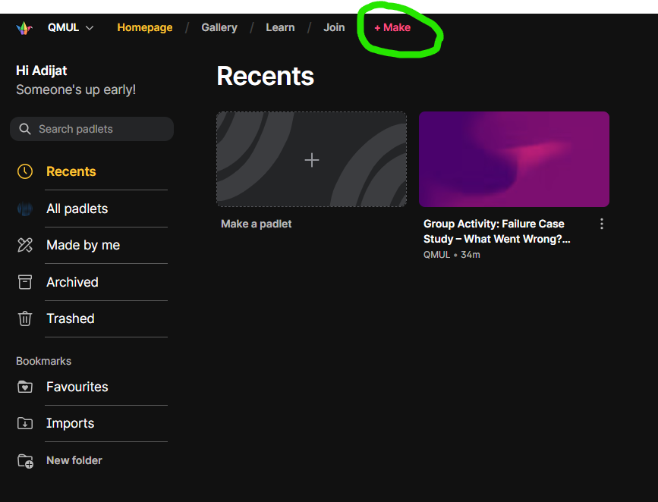
Create the Padlet
Sign up
Go to padlet.com here
Create an account (use your institutional email)
Click “Make a padlet”

Slide 3
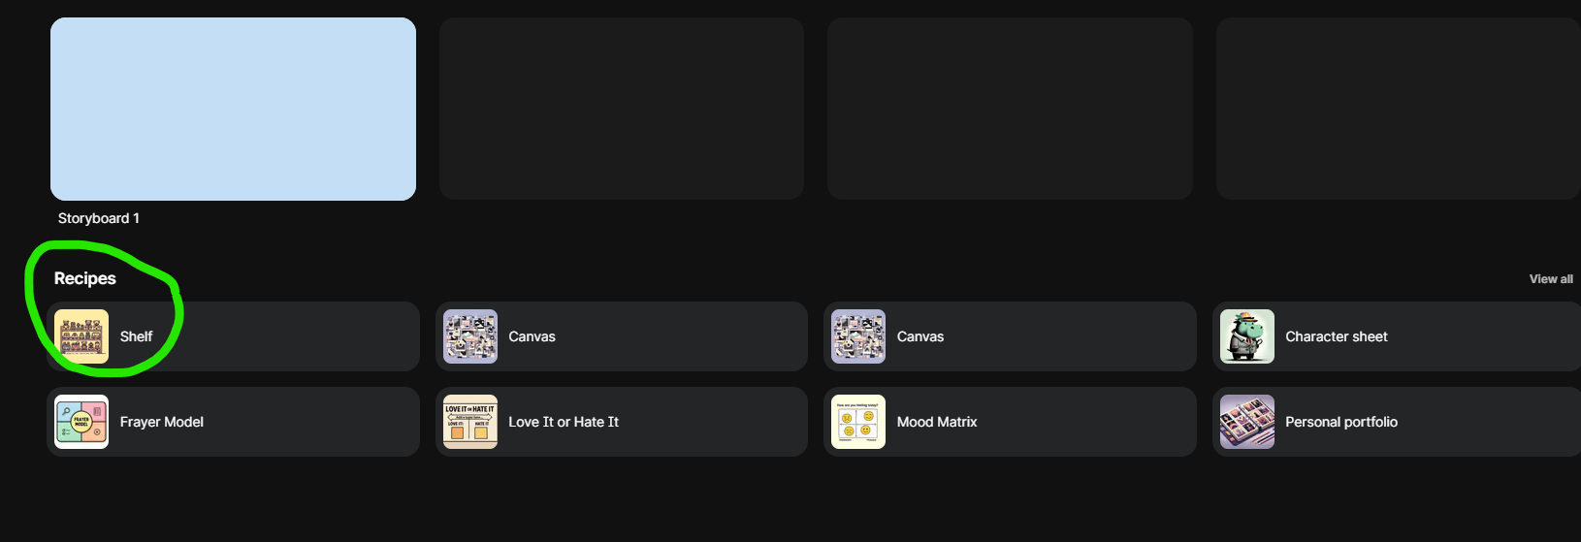
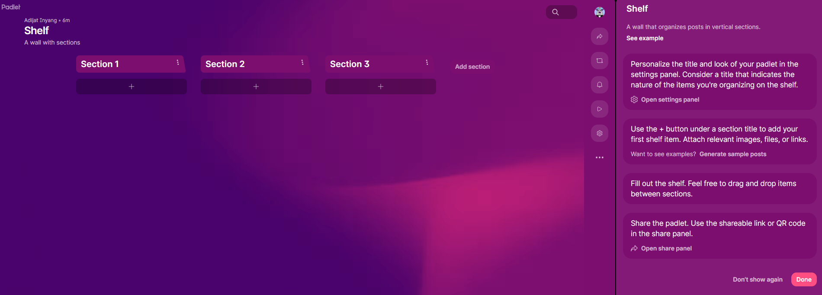
Create the Padlet
Scroll down and Choose “Shelf” layout (sections), this works best for group‑based work.
Click on done.

Slide 4
Create the padlet
Click on “Add section” and create as many sections as needed:
For example:
A section titled ‘Warm-Up’
A section for each group (e.g. Group 1, Group 2…)
A section titled ‘Group Summary & Comparison’

Slide 5
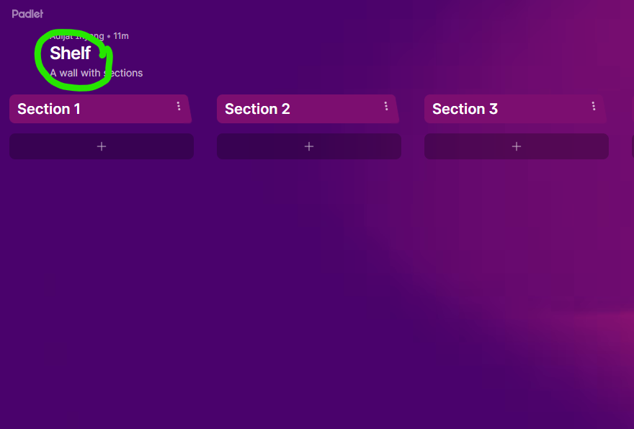
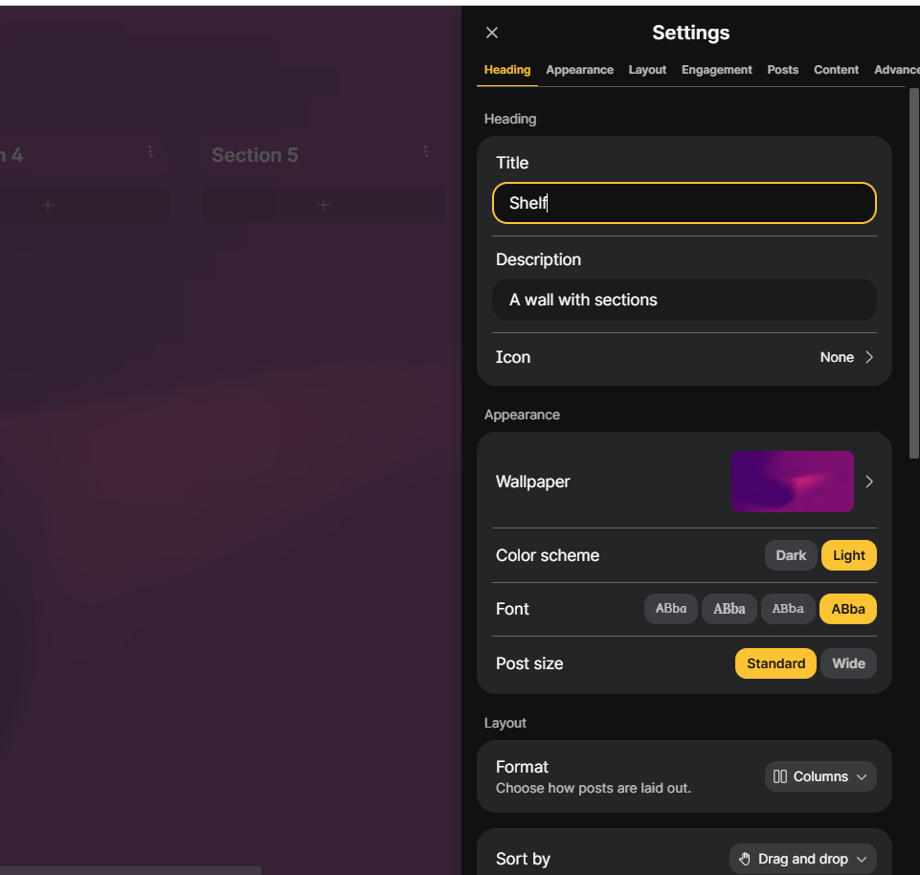
Create the Padlet
Click on Shelf

Slide 6
Create the padlet
Name and description – You can copy and paste and modify as necessary.
Title: Peer Learning – Group Presentations
Description: e.g. “Each group will present one contraceptive method. Use this Padlet to post: key takeaways, questions, clinical scenarios, and group summaries. This activity supports peer‑assisted learning and contraceptive counselling skills.”
Appearance
Choose a simple background.
Keep font and colour standard.

Slide 7
Create the sections
First section: Warm‑Up
Title: Warm‑Up: What I Know / What Confuses Me
Description: “As a group, discuss and post one thing you already know about the topic and one thing your group finds confusing. Put your Group Number in front of your post.”

Slide 8
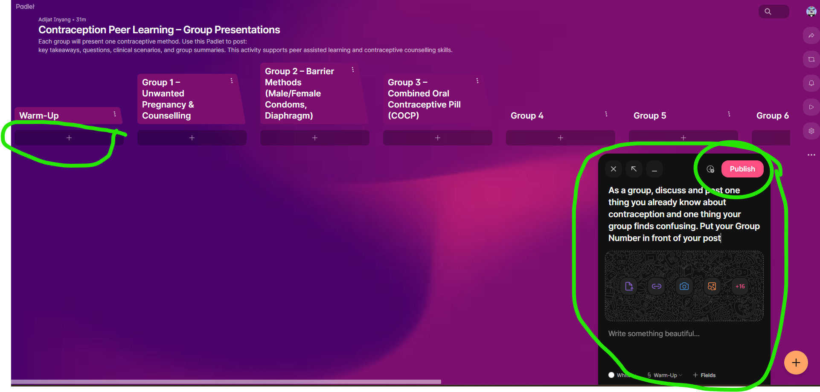
Create the sections

Slide 9
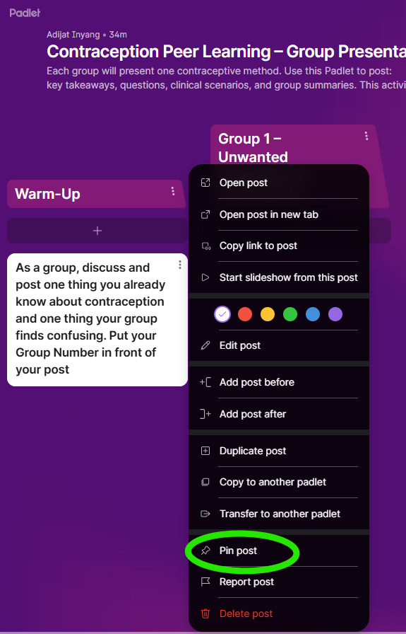
Create the sections

Slide 10
Create the sections
A section per group: Group Tasks Spaces
Give each group a section with group number and their task. It could be the same tasks for all or different tasks.
For example:
Group 1 – Unwanted Pregnancy & Counselling
Group 2 – Barrier Methods (Male/Female Condoms, Diaphragm)
Group 3 – Combined Oral Contraceptive Pill (COCP)
Do the same for all the groups
In each section’s description, add prompts:
For example: “This is the space for Group X. During and after your presentation, other groups will post: • 1 key takeaway • 1 question • Peer feedback and useful resources.”

Slide 11
Create the sections
You may have a “Final Section: Group Summary & Comparison” (or as required)
Title: Group Summary & Comparison
Description for example:
“Group Comparison. After all presentations, each group posts”:
A 3–4 sentence summary of your method
1‑minute explanation
See below screenshot, with the description pinned:

Slide 12
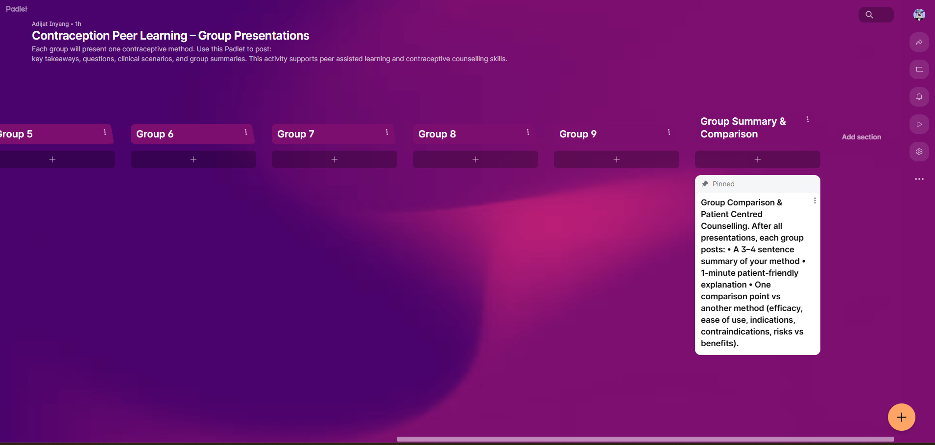
Create the sections

Slide 13
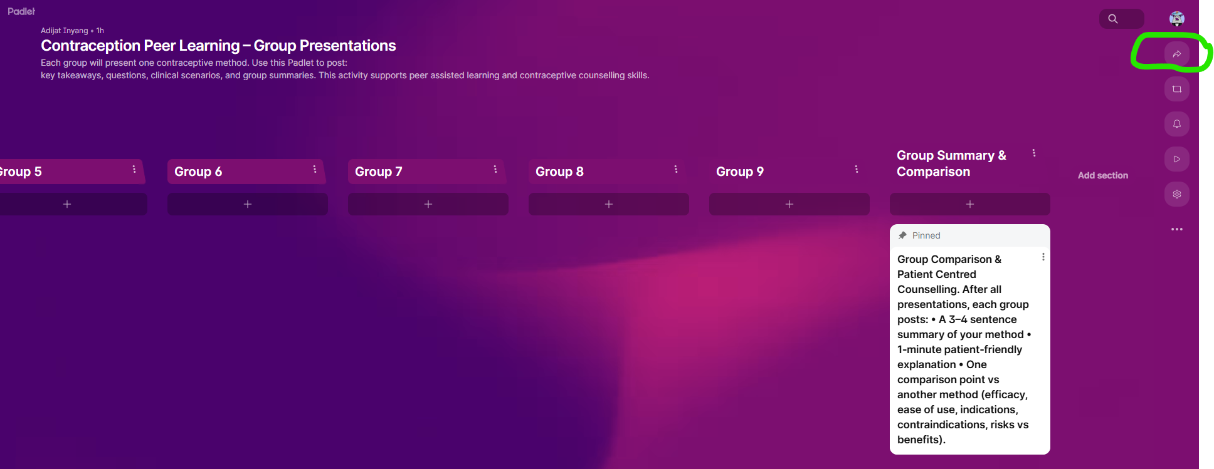
Set permissions and sharing
Click “Share” (top right).
Follow the settings below to ensure that students can write/posts and use the ‘Get QR code” to copy the link or share the QR code via email or any other communication platform.

Slide 14
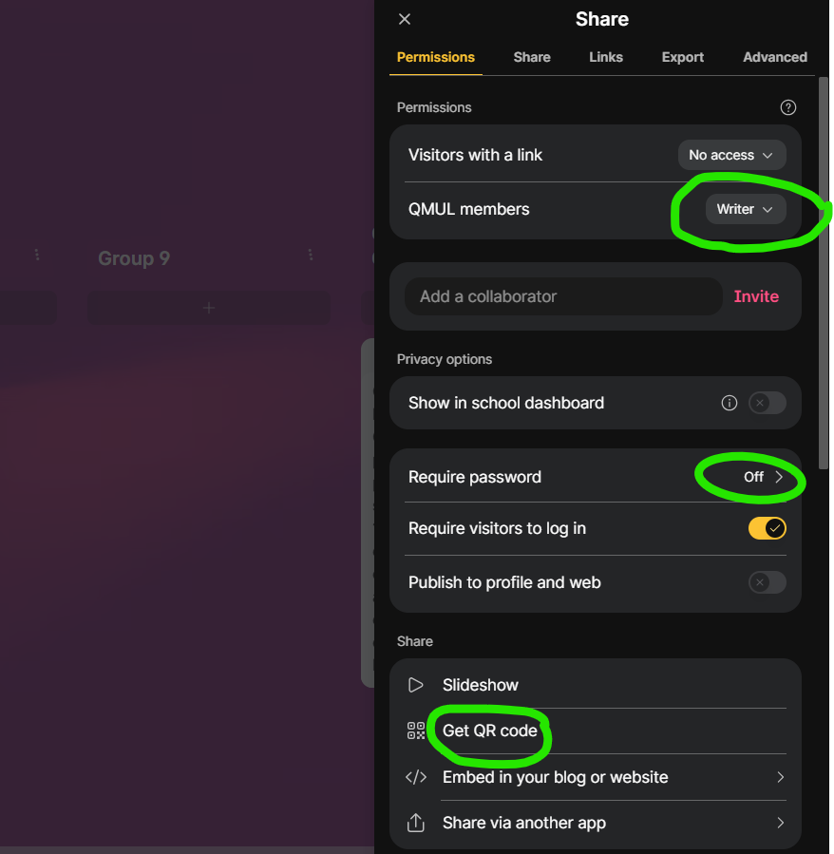
Set permissions and sharing
You could turn off the “Require password” to enable easy access by the students.
If you do not want the students to start logging-in,
You could turn-off “Require visitors to log in”.
See the screenshot

Slide 15
Group allocations and focus
Students will work in small peer groups for this PAL activity. Each group may be assigned a same tasks or specific focus area related to the overall topic or same tasks
Groups are pre-allocated by the lecturer or facilitator.
Each group may be responsible for exploring one defined aspect of the task.
All groups contribute their outcomes to the shared Padlet, allowing everyone to learn from each other’s work.
Group focus
Each group should:
Engage collaboratively with the assigned focus area
Discuss key ideas, examples, or challenges within the group
Summarise agreed points clearly on Padlet for peer learning and comparison

Slide 16
Basic instructions for using Padlet (for students)
To contribute to the Padlet activity, please follow the steps below:
Add a post Click the “+” button at the bottom of the relevant section or column.
Title your post Use a clear and descriptive title, for example: “Key takeaway – Group [number]” or “Summary of discussion”.
Write your content Use short, clear points. Focus on the main ideas rather than long paragraphs.
Add links or files (optional) Use the attachment icons to include documents, images, links, or short videos where relevant to support your contribution.

Slide 17
Facilitator guide (step‑by‑step in-class delivery)
Before class (setup)
Set up the Padlet
Ensure all sections/columns are created.
Test the link and QR code to confirm access works on student devices.
Plan group structure
Allocate students into groups.
Assign tasks to the groups or assign each group a focus area / prompt / topic (or provide a method for groups to self-select).
Brief students in advance (email / QMplus announcement / Teams / etc.)
Explain that they will deliver a short group contribution (e.g., a mini-presentation or summary).
Confirm they will also collaborate as a group on Padlet during/after the session.
Optional message you can reuse (generic)
You will work in small groups on a focused prompt and post your group output on Padlet. You may also be asked to share a summary with the class.

Slide 18
Facilitator guide (step‑by‑step in-class delivery)
Step 1 – Warm-up
Ask each group to add one post in the Warm-Up section of Padlet that includes:
One thing they already know about the topic
One thing they find unclear, challenging, or confusing
As students post:
Briefly scan the Padlet in real time
Highlight a few recurring themes, questions, or misconceptions to the class
This helps surface prior knowledge, set expectations, and guide focus for the rest of the session.
Please note: This step works well as an activation of prior knowledge or diagnostic check in any discipline.

Slide 19
Facilitator guide (step‑by‑step in-class delivery)
Step 2 – Group tasks with live Padlet use
For each group, follow the same structured pattern to support active listening and peer learning:
Group activity
One group leads the task (e.g. short presentation, explanation, or summary of their focus area).
Live Padlet contributions (by other groups)
While the group is presenting, all other groups add one group post (not individual posts) in the presenter’s section that includes:
One key takeaway (from their group’s perspective)
One question for clarification, extension, or discussion
Group representative
Each group should nominate one member to type and submit the Padlet post on behalf of the group.
This approach ensures all students are engaged, promotes peer questioning, and creates a shared learning resource.
Please note: “Presentation” can be replaced with discussion, case study, problem explanation, or demonstration, depending on your discipline.

Slide 20
Facilitator guide (step‑by‑step in-class delivery)
Step 3 – PAL discussion
After all groups have contributed to Padlet:
Each group
Reviews posts made by other groups across the Padlet sections
Selects:
1–2 questions to respond to or comment on the posts
1 scenario, example, case study, or perspective (depending on the discipline) to discuss briefly
Facilitator role
Clarifies or corrects any inaccuracies where needed
Highlights strong contributions and effective peer explanations
Connects discussion points back to the intended learning outcomes
This stage consolidates learning through peer explanation, dialogue, and guided feedback.
Please note: This works well for reinforcing critical thinking, explanation, and comparison across groups.

Slide 21
Facilitator guide (step‑by‑step in-class delivery)
Step 4 – Group comparison & synthesis
Direct all groups to contribute to the final synthesis section on Padlet.
Each group should add one group post that includes:
A 3–4 sentence summary of their approach, method, key idea, concept, argument, strategy, solution, or perspective, depending on the task.
A brief explanation of how they would explain this in simple, accessible language to someone new to the topic
This stage encourages comparison across groups and supports consolidation of understanding through translation and synthesis.
Please note: You may prompt groups to consider their explanation for a non-specialist audience or a first-year student. This section works well as a revision resource or post-class reference.

Slide 22
Facilitator guide (step‑by‑step in-class delivery)
Step 5 – Reflection, follow-up, and assessment link (5–10 minutes or post-class)
Use this final step to consolidate learning and, where appropriate, connect the PAL activity to ongoing coursework or assessment.
Student reflection
Ask students (individually or as groups) to complete a short survey or reflection, either in class or after the session:
One thing they understand better as a result of the peer discussion
One question or area they would like to explore further
One skill developed during the activity (e.g. explaining ideas, questioning, collaboration)
This can be completed on Padlet, MS forms, Qmplus or as a brief written submission.
Follow-up activities (optional)
Revisit selected Padlet posts in the next class to address common questions
Ask students to refine or expand their posts after feedback
Use Padlet contributions as a revision or study resource
Link to assessment (optional)
Clarify how this activity supports formative learning or prepares students for summative assessment
Where appropriate, explain whether Padlet engagement contributes to:
participation marks
reflective writing
group coursework or presentations

Slide 23
Facilitator guide (step‑by‑step in-class delivery)
Facilitator-led synthesis and discussion
The facilitator then:
Selects a few Padlet posts to read aloud or highlight
Uses these posts to prompt whole-class discussion, drawing comparisons across groups
Suggested discussion prompts (adapt as needed):
Which approaches, methods, strategies, models, tools, interventions, theories, or solutions appear most effective and why?
Which options are easiest to use, apply, or implement in practice?
What limitations, risks, or constraints should be considered?
In which contexts do additional benefits or wider impacts matter most?
In time-critical or high-stakes situations, which option would you choose and why?
The facilitator should:
Guide discussion using evidence and reasoning
Clarify misconceptions where needed
Encourage students to justify choices and compare perspectives.
Please note: Prompts can be tailored to focus on effectiveness, usability, ethics, risk, accessibility, or context, depending on the discipline. This step is particularly effective for comparison, decision-making, and application of knowledge.

Slide 24
Facilitator guide (step‑by‑step in-class delivery)
After class
Preserve the Padlet
Export the Padlet or keep it accessible as a shared revision and reference resource.
Signpost students to revisit it when preparing for assessments or further study.
Provide brief follow-up feedback (optional)
Share a short feedback note with the cohort or groups highlighting:
Common strengths observed
Common misconceptions or areas for improvement
Examples of effective peer contributions
This helps close the feedback loop and reinforces learning beyond the live session.
Please note: Feedback can be delivered via email, QMplus announcement, or short in-class recap.

Slide 25
Student guidance (group‑based)
Your group task
You will be working in groups for this activity. There are no individual marks for Padlet contributions unless stated otherwise.
As a group, you are expected to:
Prepare a short group contribution on your assigned topic, approach, or focus area (e.g. presentation, explanation, case summary, or demonstration)
Contribute group posts to Padlet during other groups’ contributions by:
Identifying one key takeaway
Posing one question for discussion
Create a final group summary and comparison, synthesising your approach with those of other groups
This activity is designed to support shared learning, comparison of ideas, and peer discussion.

Slide 26
Student guidance (group‑based)
How your group uses Padlet
Padlet will be used as a shared group workspace throughout the session. All posts should be made on behalf of your group, not individually.
Warm-up (start of session)
As a group, add one post in the Warm-Up section that includes:
One thing your group already knows about the topic
One thing your group finds unclear or confusing
During other groups’ contributions
For each group, your group should add one post in that group’s section with:
One key takeaway from their contribution
One question for clarification, extension, or discussion
(One group member can type the post on behalf of
the group.)
After your own contribution
Once your group has completed your tasks:
Review the posts in your group’s section
Decide together:
Which 1–2 questions to respond to
Which example, scenario, or point to discuss briefly with the class
Final synthesis
In the final synthesis section, your group should post:
A 3 - 4 sentence summary of your approach, idea, or method
A brief explanation of how you would explain this in simple, accessible language
Tips for success
Focus on clarity rather than length
Agree on key points before posting
Use Padlet posts to support discussion, not just to record notes

Slide 27
Student guidance (group‑based)
Expectations
Work collaboratively Everyone in the group should contribute to discussions, decisions, and Padlet posts.
Use appropriate, evidence-informed sources Base your contributions on reliable and relevant information for the context of the task.
Be respectful and constructive Ask questions and discuss scenarios in a professional, supportive, and inclusive way.
These expectations help create a positive learning environment where all students can participate and learn from each other.

Slide 28
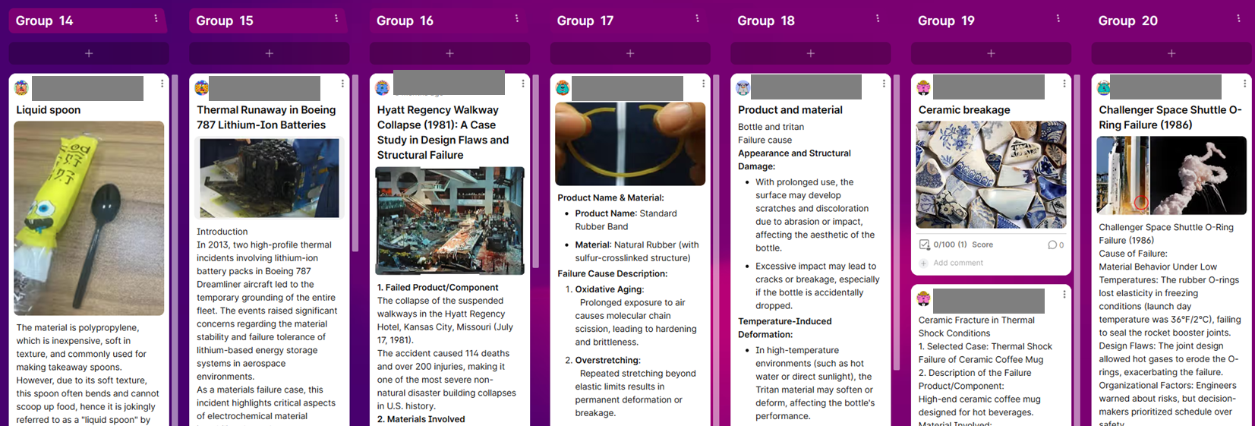
Screenshot of a completed Padlet PAL task

